Slide 1
Capstone Project
Smart Living Sydney Providing Housing Services
Boon Fooi Cheng

Slide 2

Living in Sydney

Slide 3
Introduction
Immigration service company, Smart Living Sydney is planning to expand its business to provide housing advises and services to clients in addition to immigration services
As a start, the company is focusing on providing housing services for clients who are interested to live in Sydney

Slide 4
Problem Description
Provide an overview of the Sydney based on venues available in all suburbs
Based on the information acquired, the company is able to help clients from different cultural background to live in a suburb best suit them
This study is focused on venue the following venue categories: restaurants, grocery stores, schools and public transports
The company is focusing on clients from Chinese, Malaysian, Italian and Indian background

Slide 5
Data Source and Preparation
The full list of Sydney suburbs is retrieved from this link: https://www.intosydneydirectory.com.au/sydney-postcodes.php
This list include columns: Suburb, State and Postcode
As “State” is a constant value “NSW”, it is redundant data and it is discarded
Python Geocoder is used to retrieve location (Latitude and Longitude) for each suburb
FourSquare is used to retrieve venue information for each suburb
Venues related to Chinese, Indian, Malay and Italian are extracted
Other important venues extracted including schools and public transports

Slide 6
Missing Data
No school venues returned by FourSquare
FourSquare is not able to provide different type of grocery store other than the general store

Slide 7
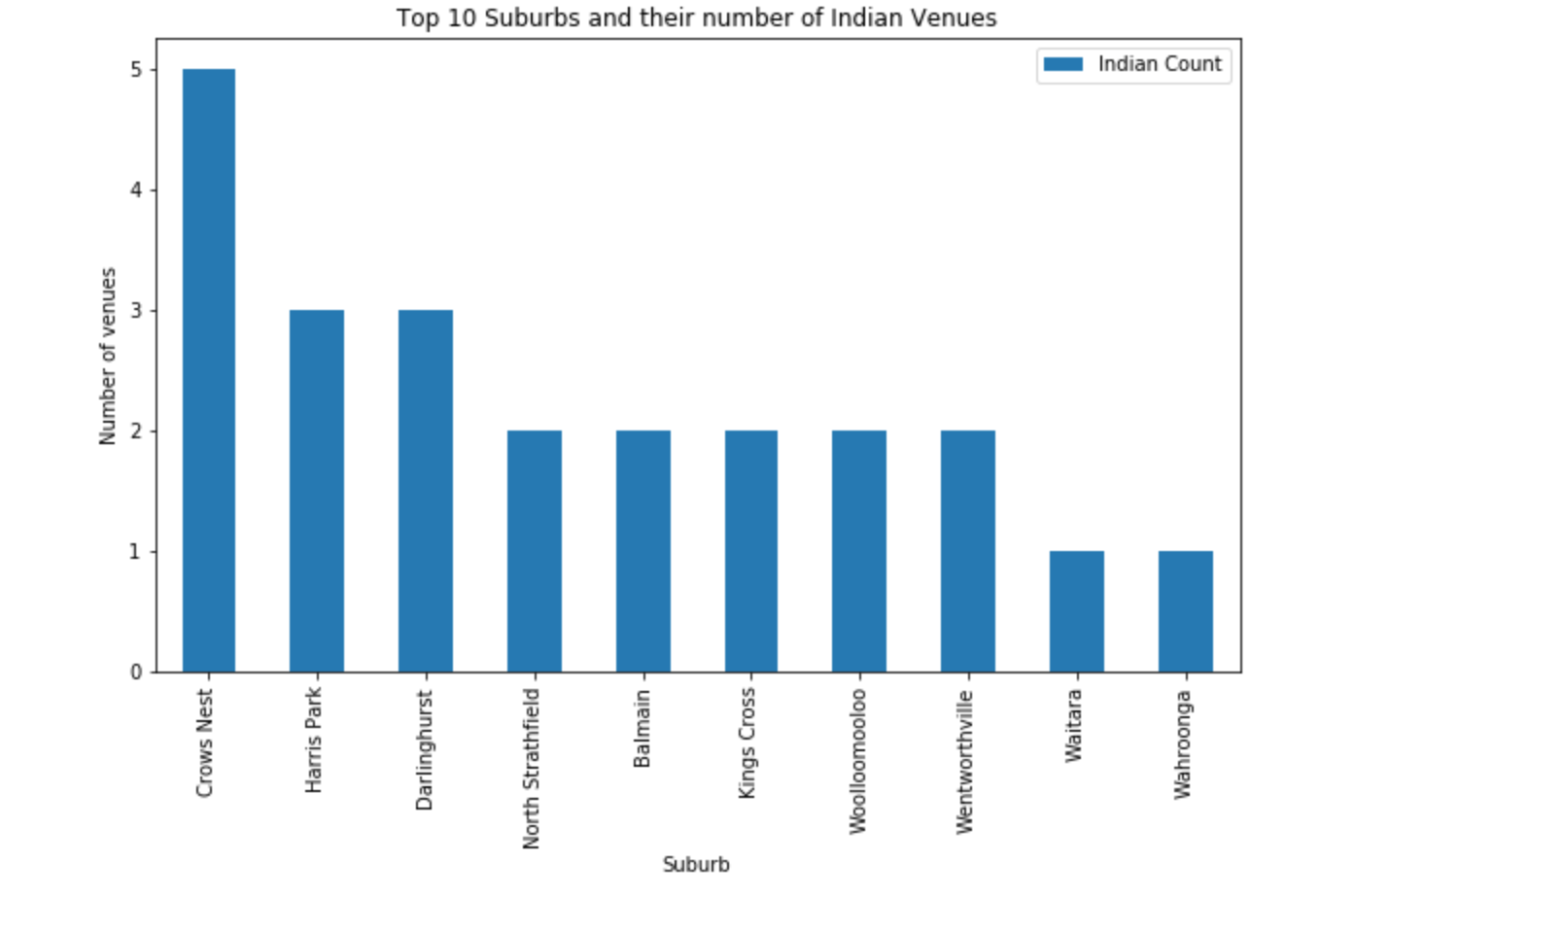
Top 10 Suburbs with Indian Venues

Slide 8
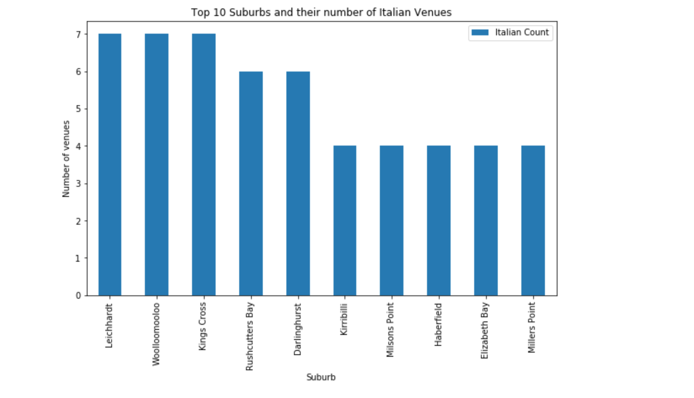
Top 10 Suburbs with Italian Venues

Slide 9
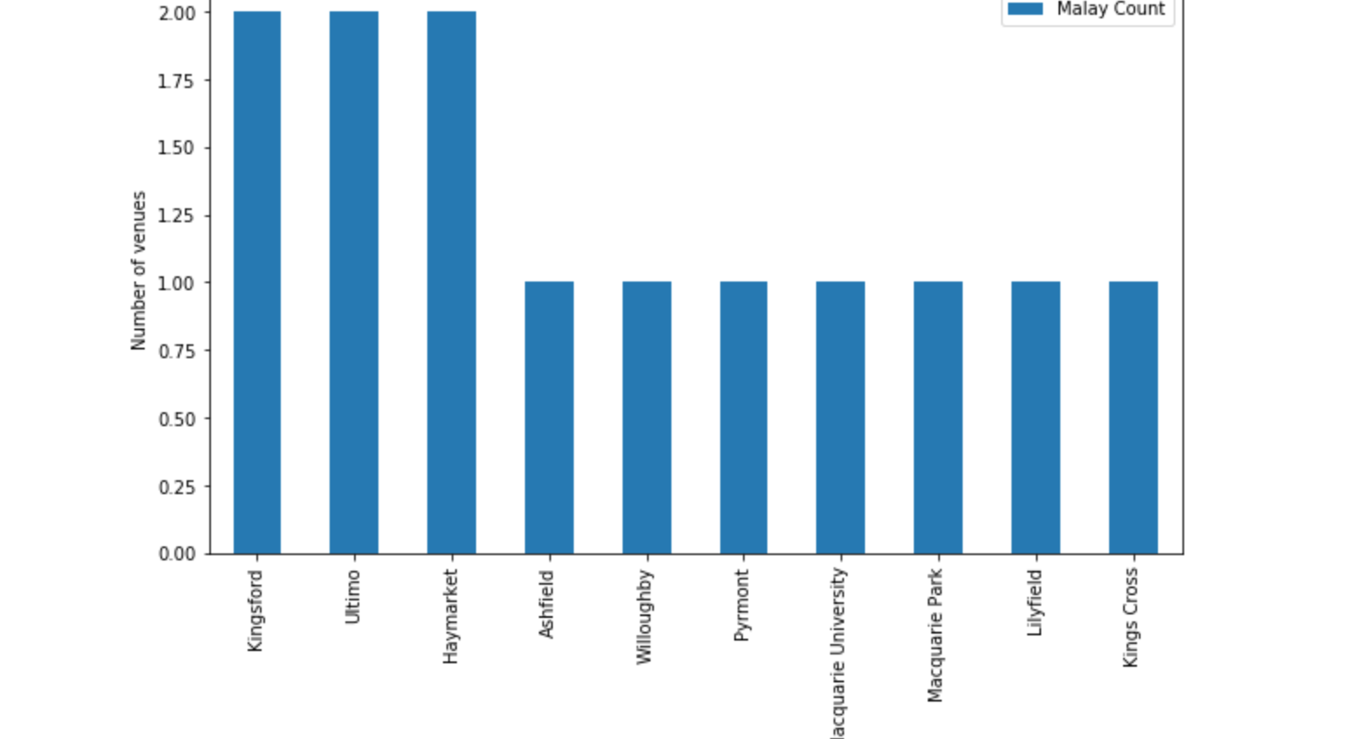
Top 10 Suburbs with Malaysian Venues

Slide 10
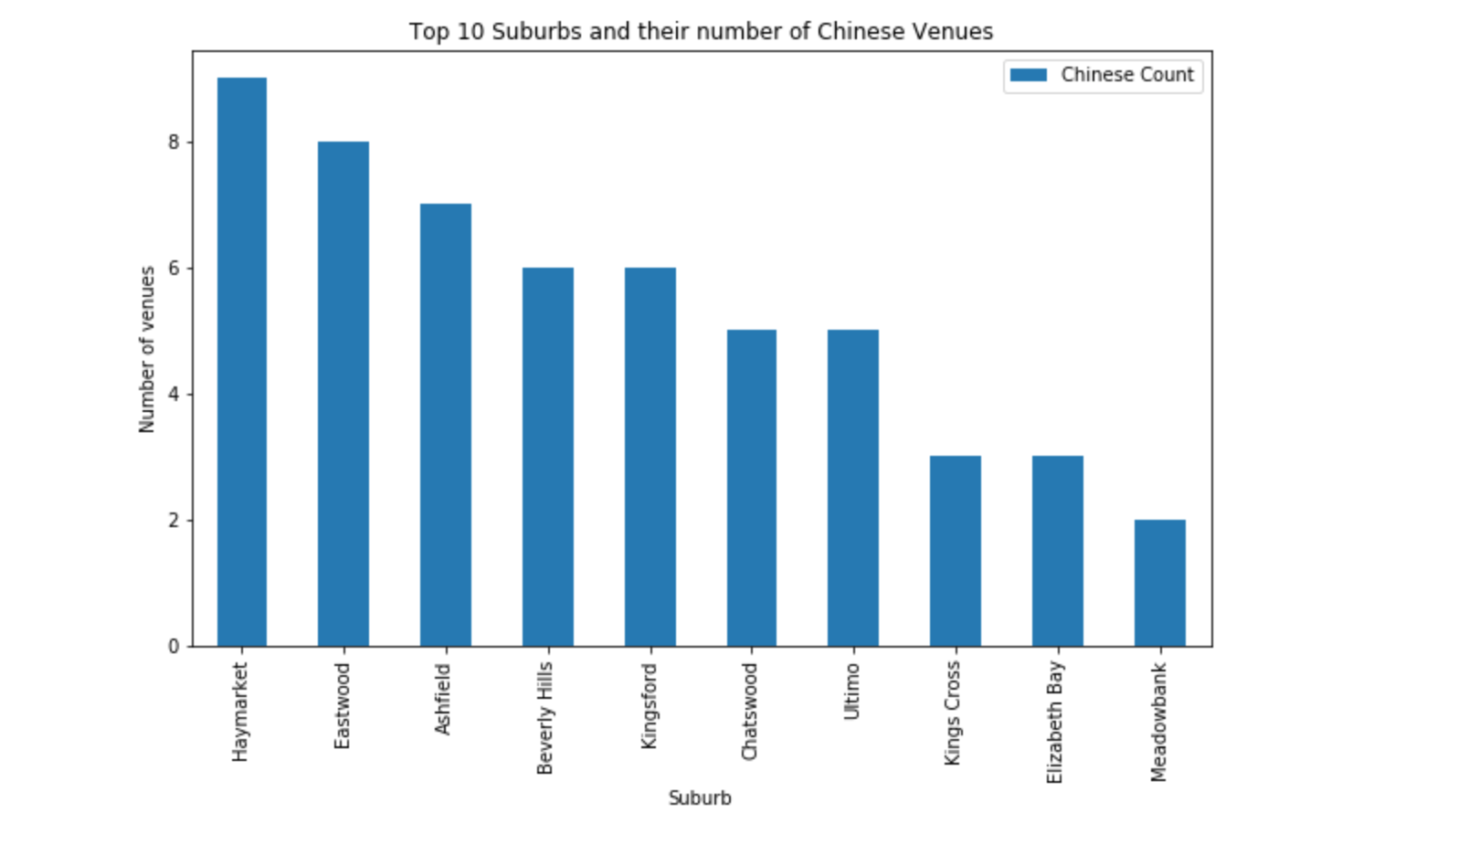
Top 10 Suburbs with Chinese Venues

Slide 11
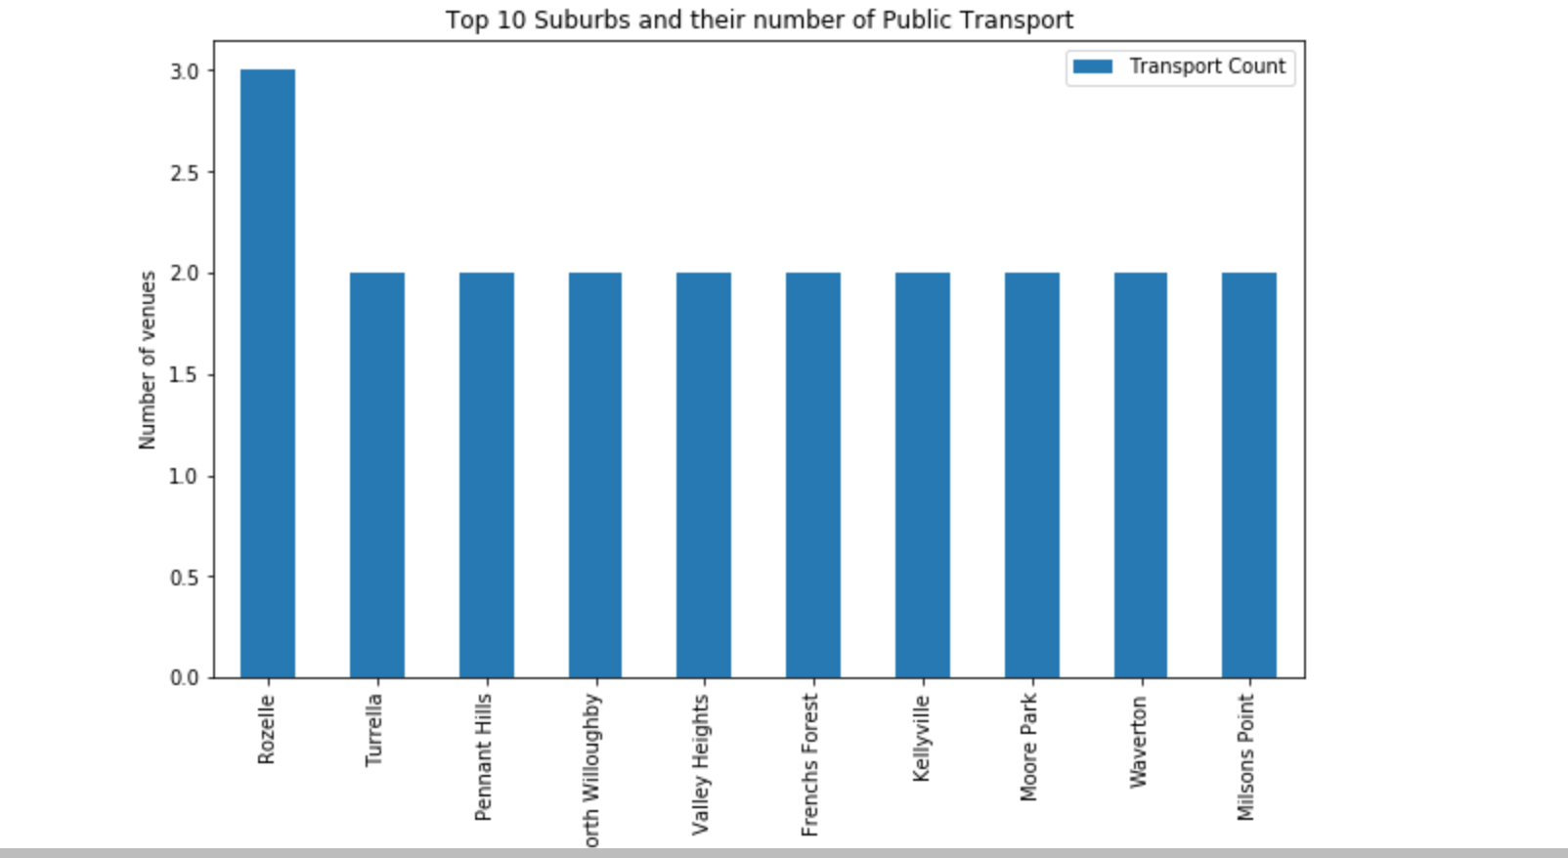
Top 10 Suburbs with Public Transport

Slide 12
Clustering of Sydney Suburbs
K-Means modeling is used to perform clustering of Sydney suburbs
Suburbs are divided into 5 clusters
Housing cost of some suburbs is high even though they are ideal place to live. With the finding of the K-means clustering, we can propose other similar suburbs to live in with lower housing cost

Slide 13
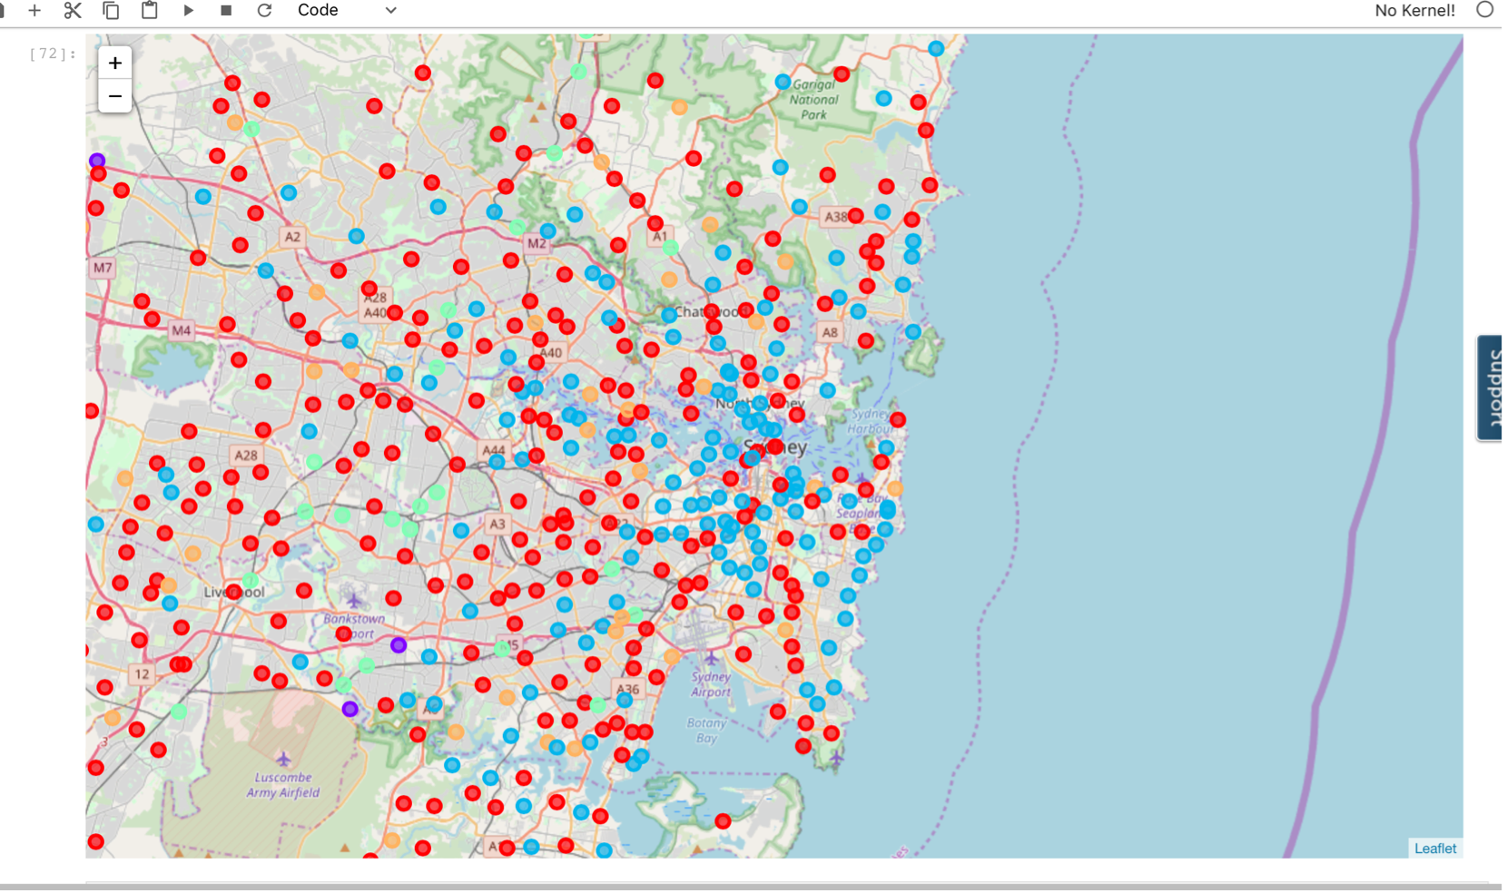
Sydney Map K-Means Clusters Map

Slide 14
Discussion and Investigation of Results
Results presented are heavily based on information provided by FourSquare
Has FourSquare provided complete set of venues?
Venues returned is depends on LIMIT and RADIUS set when setting up FourSquare url, different values of these two parameters might give different results
Venues returned by FourSquare related to Indian, Chinese etc. are mainly restaurants. We have no information of other important venues such as grocery stores
No school venue given by FourSquare, this is one of the important information for clients who has children of school age
The public transport venues returned by FourSquare are limited. We have found the top suburb has 3 venues and other suburbs are having 2 venues. Therefore based on the limited data we have, it is hard for us to make conclusion which suburbs provide better public transport

Slide 15
Future Direction
Acquire and provide school information to clients
More detailed research of public transport facilities including frequencies and traveling time to major business districts
Provide type of grocery stores, for example Indian or Italian?
More detailed research of housing cost for cluster of suburbs in order to provide different housing options for clients

